Slide 1

Design And Fabrication of Scroll saw
KATHMANDU UNIVERSITY
BATCH:2023(1ST YEAR 2ND SEMESTER )
Team Members
Supervisor
David Ojha
Kushal Dahal
Pratik Subedi
Shirish Karmacharya
Sirish Shrestha
Asst. Prof Bijendra Shrestha
1

Slide 2
TABLE OF CONTENTS
1.Introduction
2.Objectives
3.Limitatations
4.Significance
5.Methodology
6.Project Design
7.Components Required
8.Road Map
9.Budget Estimation
10.Expected Outcomes
2
1

Slide 3
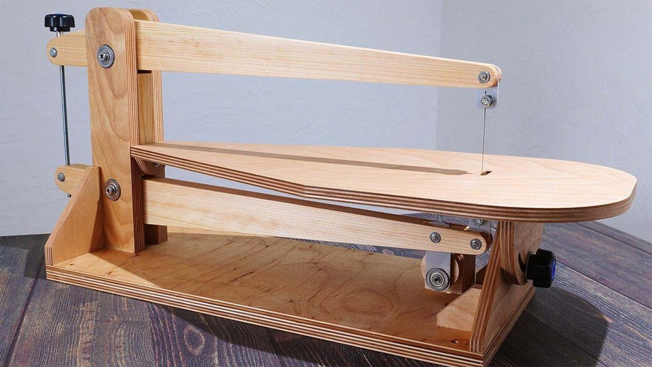
INTRODUCTION
Scroll saw is a small electric operated saw used to cut intricate curves in wood, metals and other materials.
It is primarily used for making intricate and detailed cuts in wood, metals, and other materials.
Scroll saws use thin, straight blades, which allow for intricate designs and tight curves.
Scroll saws operate using a motor to move the blade up and down, allowing for intricate cutting motions.
Fig:Scroll Saw
3

Slide 4
OBJECTIVES
The primary and secondary objectives of the project are:
Primary Objectives:
To study, design, fabricate and construct a functional scroll saw from basics materials and components.
Secondary Objectives:
To cut precisely in wood, metal, or other materials.
To evaluate the safety and accuracy.
4

Slide 5
SIGNIFICANCE
The Significance of Scroll saw are:
1.It can cut a variety of materials, including wood, plastic, metal.
2. Scroll saws are easy to use.
3.Scroll saw offers better control and safety.
5

Slide 6
LIMITATIONS
The limitations are:
1.Different blades should be used while cutting different materials.
2.The cutting stroke is only in one direction.
3.Scroll saw blades are thin in size and can break easily, especially when cutting a hard materials.
.
6

Slide 7
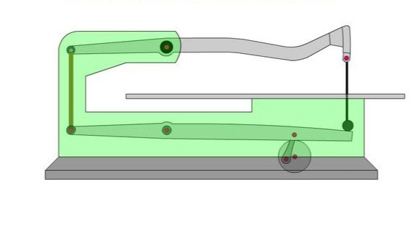
METHODOLOGY
Theoretical Framework
Working Mechanism
1.The fabrication of a scroll saw is done by fitting major components like base, Table, Blades, Blade clamp,Upper arm, Upper blade guide, lower arm, Lower blade guide, variable speed control, Battery, etc. in a body.
2.An electric motor gives power to the scroll saw which in return converts electrical energy into mechanical energy.
3.The motor then moves the blade in an up and down motion with the help of belts, pulleys or gears.
7

Slide 8
Methodology
4.The upper and lower blade guides help in stabilizing the blades which help for precise and accurate cutting.
5.The operator then controls the speed and direction of the blade, guiding it through the workpiece to create intricate cuts according to what we desire or design.
8

Slide 9
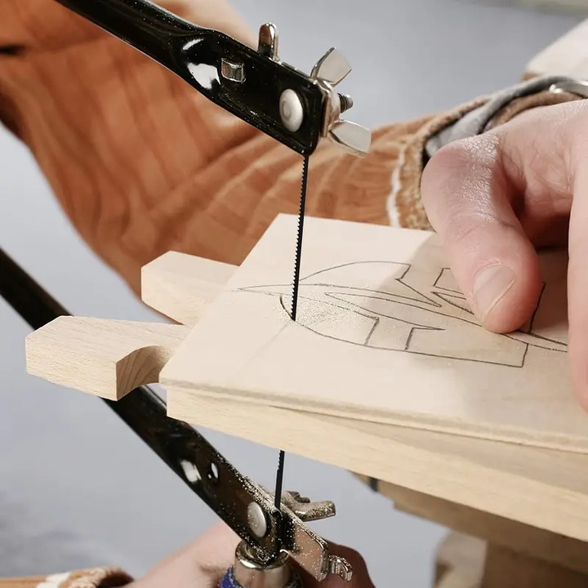

PROJECT DESIGN
Fig:Cutting Process
Fig:Final Product
9

Slide 10
Components Required
COMPONENTS | SPECIFICATION | MATERIAL
Swing Arms | Length 66cm | Wood
Pillar Supports | 50cm | Wood
Clamping Bolts | 10mm diameter, 30cm length | Mild Steel
Blade | Blade length 127mm
Electrical system | Transformers, Wires and Circuit Boards | Copper wire
Braking System | Kill Switch
Motor | DC motor 775
Bearings | Diameter 12mm
10

Slide 11
MACHINING PROCESS | EQUIPMENT OR TOOLS REQUIRED
Cutting | Hack Saw, Snip, Scissors, Rip Saw, Shear, Chisel, Hand Saw, Bench vice
Drilling | Hand drill, Bench Drill Machine
Grinding | Grinder, Sand-Disc, Angle Grinder
Soldering | Soldering (Machine, Wire, Paste)
Clamping | Clamps, Clips
Bending | Bench Vice, Bending Pipe, Bending Machine
Welding | Welding Machine, Welding Rod, Welding Helmet
Electrical Systems | Wires, Clips and Clamps, Tape
Assembling | Wrench Set, Screwdriver Set, Hammer Set, Allen Keys and Allen Screws, Washers
Others | Battery Chargers, Die and Tape, Nuts and Bolts, Screws, Pliers, File (Metal and wood), Sandpaper (Metal and Wood), Grease, Hinges, Trays, Nails.
11

Slide 12


Road Map
Final Product
Fabrication
Collection of Required Materials
Presenting project Idea
Selection of project
12

Slide 13
Budget Estimation
SN | Material and components | Quantity | Rate | Amount
1 | Motor 775 | 1 | 900 | 900
2 | Bearing | 14 | 120 | 1680
3 | Wires | 3 meter | 25 | 75
4 | Mild steel | 1 meter | 150 | 150
5 | Wood(3*1) | 2
6 | Ply | 2*1 meter
7 | DC adapter | 1 | 800 | 800
8 | Timer 555 ic | 1 | 100 | 100
9 | Mosfet | 2 | 50 | 100
10 | Capicator | 2 | 100 | 200
11 | Potentiometer | 1 | 100 | 100
12 | Nut and bolts | 13 | 15 | 195
13 | Clamp bolts long | 1 | 150 | 150
14 | Clamp bolts short | 1 | 100 | 100
15 | Blades | 1 | 250 | 250
Total |  | --------------------------- |  | 4800
13

Slide 14
EXPECTED OUTCOMES
The expected outcome of project is mentioned below:
The expected outcome of the design and manufacture of scroll saw project is to develop a cost effective and efficient device which help to cut precisely in wood, metal, or other materials.
Fabrication of Scroll saw.
Enhanced Scroll Saw Design Guidelines.
Identify and validate optimal cutting techniques.
Identify opportunities for improvement and promote the development of more sustainable manufacturing practices within the industry.
Development of innovative scroll saw technologies.
14

Slide 15
THANKYOU !
15

